Slide 1
Scoring and results assembly

Slide 2
Why is ranking so important?
  Problems with unranked retrieval
    Users want to look at a few results – not thousands.
    It’s very hard to write queries that produce a few results.
    Even for expert searchers
    → Ranking is important because it effectively reduces a large set of results to a very small one.
  Next: More data on “users only look at a few results”
  Actually, in the vast majority of cases they only examine 1, 2, or 3 results.

Slide 3
Empirical investigation of the effect of ranking
  How can we measure how important ranking is?
  Observe what searchers do when they are searching in a controlled setting
    Videotape them
    Ask them to “think aloud”
    Interview them
    Eye-track them
    Time them
    Record and count their clicks
  The following slides are from Dan Russell’s JCDL talk
  Dan Russell is the “Über Tech Lead for Search Quality & User Happiness” at Google.

Slide 4
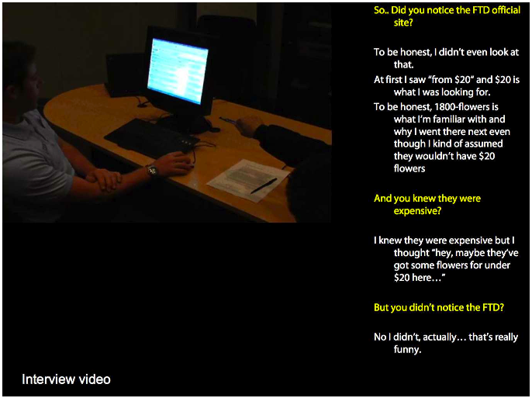

Slide 5
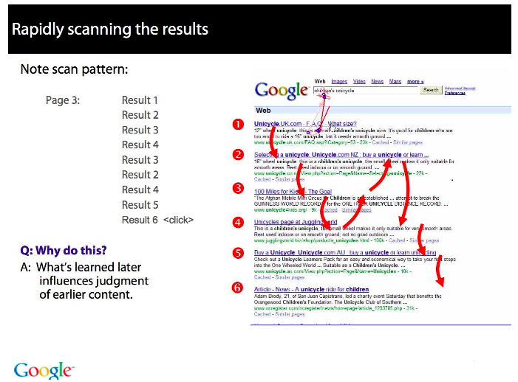

Slide 6
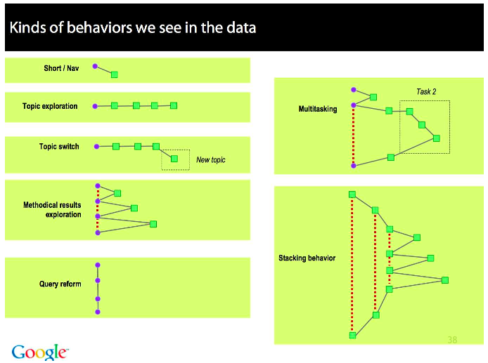

Slide 7
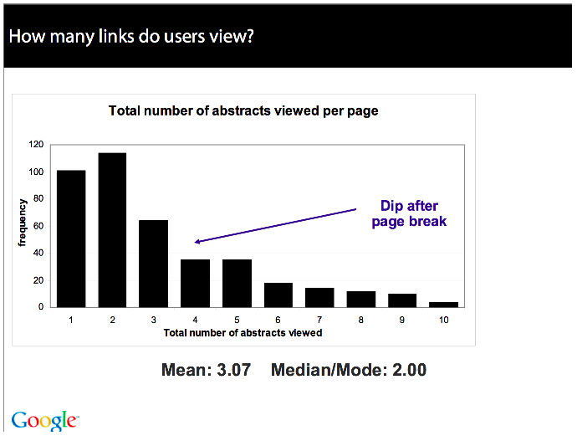

Slide 8
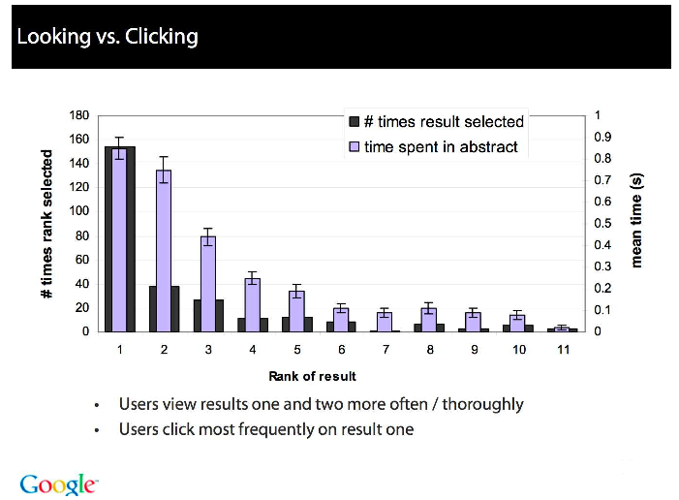

Slide 9
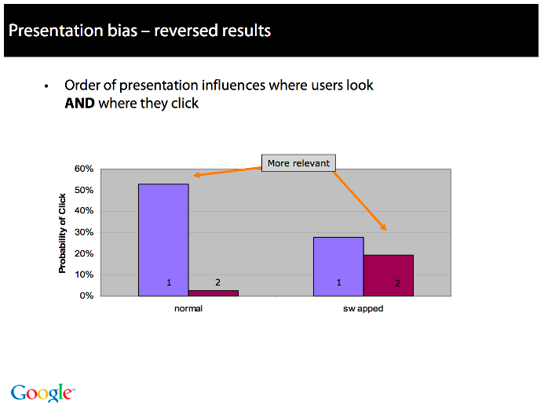

Slide 10
Importance of ranking: Summary
  Viewing abstracts: Users are a lot more likely to read the abstracts of the top-ranked pages (1, 2, 3, 4) than the abstracts of the lower ranked pages (7, 8, 9, 10).
  Clicking: Distribution is even more skewed for clicking
  In 1 out of 2 cases, users click on the top-ranked page.
  Even if the top-ranked page is not relevant, 30% of users will click on it.
  → Getting the ranking right is very important.
  → Getting the top-ranked page right is most important.

Slide 11
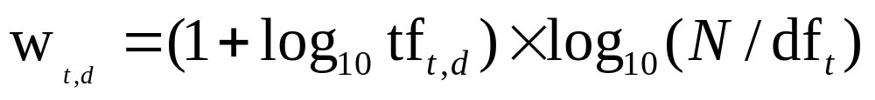
Recap: tf-idf weighting
The tf-idf weight of a term is the product of its tf weight and its idf weight.
Best known weighting scheme in information retrieval
Increases with the number of occurrences within a document
Increases with the rarity of the term in the collection

Slide 12
Recap: Queries as vectors
Key idea 1: Do the same for queries: represent them as vectors in the space
Key idea 2: Rank documents according to their proximity to the query in this space
proximity = similarity of vectors

Slide 13

Recap: cosine(query,document)
Dot product
Unit vectors
cos(q,d) is the cosine similarity of q and d … or,
equivalently, the cosine of the angle between q and d.

Slide 14
This lecture
Putting together a complete search system
  Will require learning about a number of miscellaneous topics and heuristics

Slide 15

Computing cosine scores

Slide 16
Efficient cosine ranking
Find the K docs in the collection “nearest” to the query ⇒ K largest query-doc cosines.
Efficient ranking:
  Computing a single cosine efficiently.
  Choosing the K largest cosine values efficiently.
    Can we do this without computing all N cosines?

Slide 17
Efficient cosine ranking
What we’re doing in effect: solving the K-nearest neighbor problem for a query vector
In general, we do not know how to do this efficiently for high-dimensional spaces
But it is solvable for short queries, and standard indexes support this well

Slide 18
Special case – unweighted queries
No weighting on query terms
  Assume each query term occurs only once
Then for ranking, don’t need to normalize query vector
  Slight simplification of algorithm.

Slide 19
Computing the K largest cosines: selection vs. sorting
Typically we want to retrieve the top K docs (in the cosine ranking for the query)
  not to totally order all docs in the collection
Can we pick off docs with K highest cosines?
Let J = number of docs with nonzero cosines
  We seek the K best of these J

Slide 20
Use heap for selecting top K
Binary tree in which each node’s value > the values of children
Takes 2J operations to construct, then each of K “winners” read off in 2log J steps.
For J=1M, K=100, this is about 10% of the cost of sorting.
1
.9
.3
.3
.8
.1
.1

Slide 21
Bottlenecks
Primary computational bottleneck in scoring: cosine computation
Can we avoid all this computation?
Yes, but may sometimes get it wrong
  a doc not in the top K may creep into the list of K output docs
  Is this such a bad thing?

Slide 22
Cosine similarity is only a proxy
User has a task and a query formulation
Cosine matches docs to query
Thus cosine is anyway a proxy for user happiness
If we get a list of K docs “close” to the top K by cosine measure, should be ok

Slide 23
Generic approach
Find a set A of contenders, with K < |A| << N
  A does not necessarily contain the top K, but has many docs from among the top K
  Return the top K docs in A
Think of A as pruning non-contenders
The same approach is also used for other (non-cosine) scoring functions
Will look at several schemes following this approach

Slide 24
Index elimination
Basic algorithm cosine computation algorithm only considers docs containing at least one query term
Take this further:
  Only consider high-idf query terms
  Only consider docs containing many query terms

Slide 25
High-idf query terms only
For a query such as catcher in the rye
Only accumulate scores from catcher and rye
Intuition: in and the contribute little to the scores and so don’t alter rank-ordering much
Benefit:
  Postings of low-idf terms have many docs → these (many) docs get eliminated from set A of contenders

Slide 26
Docs containing many query terms
Any doc with at least one query term is a candidate for the top K output list
For multi-term queries, only compute scores for docs containing several of the query terms
  Say, at least 3 out of 4
  Imposes a “soft conjunction” on queries seen on web search engines (early Google)
Easy to implement in postings traversal

Slide 27
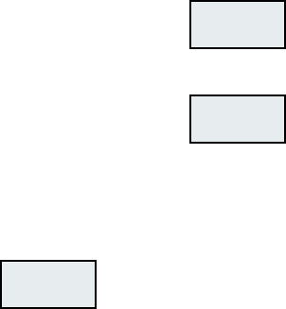
3 of 4 query terms
Antony
3
4
8
16
32
64
128
Brutus
2
4
8
16
32
64
128
Caesar
1
2
3
5
8
13
21
34
Calpurnia
13
16
32
Scores only computed for docs 8, 16 and 32.

Slide 28
Champion lists
Precompute for each dictionary term t, the r docs of highest weight in t’s postings
  Call this the champion list for t
  (aka fancy list or top docs for t)
Note that r has to be chosen at index build time
  Thus, it’s possible that r < K
At query time, only compute scores for docs in the champion list of some query term
  Pick the K top-scoring docs from amongst these

Slide 29
Static quality scores
We want top-ranking documents to be both relevant and authoritative
Relevance is being modeled by cosine scores
Authority is typically a query-independent property of a document
Examples of authority signals
  Wikipedia among websites
  Articles in certain newspapers
  A paper with many citations
  Many bitly’s, diggs or del.icio.us marks
  (Pagerank)
Quantitative

Slide 30
Modeling authority
Assign to each document a query-independent quality score in [0,1] to each document d
  Denote this by g(d)
Thus, a quantity like the number of citations is scaled into [0,1]
  Exercise: suggest a formula for this.

Slide 31
Net score
Consider a simple total score combining cosine relevance and authority
net-score(q,d) = g(d) + cosine(q,d)
  Can use some other linear combination
  Indeed, any function of the two “signals” of user happiness – more later
Now we seek the top K docs by net score

Slide 32
Top K by net score – fast methods
First idea: Order all postings by g(d)
Key: this is a common ordering for all postings
Thus, can concurrently traverse query terms’ postings for
  Postings intersection
  Cosine score computation

Slide 33
Why order postings by g(d)?
Under g(d)-ordering, top-scoring docs likely to appear early in postings traversal
In time-bound applications (say, we have to return whatever search results we can in 50 ms), this allows us to stop postings traversal early
  Short of computing scores for all docs in postings

Slide 34
Champion lists in g(d)-ordering
Can combine champion lists with g(d)-ordering
Maintain for each term a champion list of the r docs with highest g(d) + tf-idf_{td}
Seek top-K results from only the docs in these champion lists

Slide 35
High and low lists
For each term, we maintain two postings lists called high and low
  Think of high as the champion list
When traversing postings on a query, only traverse high lists first
  If we get more than K docs, select the top K and stop
  Else proceed to get docs from the low lists
Can be used even for simple cosine scores, without global quality g(d)
A means for segmenting index into two tiers

Slide 36
Impact-ordered postings
We only want to compute scores for docs for which wf_{t,d} is high enough
We sort each postings list by wf_{t,d}
Now: not all postings in a common order!
How do we compute scores in order to pick off top K?
  Two ideas follow

Slide 37
1. Early termination
When traversing t’s postings, stop early after either
  a fixed number of r docs
  wf_{t,d} drops below some threshold
Take the union of the resulting sets of docs
  One from the postings of each query term
Compute only the scores for docs in this union

Slide 38
2. idf-ordered terms
When considering the postings of query terms
Look at them in order of decreasing idf
  High idf terms likely to contribute most to score
As we update score contribution from each query term
  Stop if doc scores relatively unchanged
Can apply to cosine or some other net scores

Slide 39
Cluster pruning: preprocessing
Pick √N docs at random: call these leaders
For every other doc, pre-compute nearest leader
  Docs attached to a leader: its followers;
  Likely: each leader has ~ √N followers.

Slide 40
Cluster pruning: query processing
Process a query as follows:
  Given query Q, find its nearest leader L.
  Seek K nearest docs from among L’s followers.

Slide 41
Visualization
Query
Leader
Follower

Slide 42
Why use random sampling
Fast
Leaders reflect data distribution

Slide 43
Parametric and zone indexes
Thus far, a doc has been a sequence of terms
In fact documents have multiple parts, some with special semantics:
  Author
  Title
  Date of publication
  Language
  Format
  etc.
These constitute the metadata about a document

Slide 44
Fields
We sometimes wish to search by these metadata
  E.g., find docs authored by William Shakespeare in the year 1601, containing alas poor Yorick
Year = 1601 is an example of a field
Also, author last name = shakespeare, etc.
Field or parametric index: postings for each field value
  Sometimes build range trees (e.g., for dates)
Field query typically treated as conjunction
  (doc must be authored by shakespeare)

Slide 45
Zone
A zone is a region of the doc that can contain an arbitrary amount of text, e.g.,
  Title
  Abstract
  References …
Build inverted indexes on zones as well to permit querying
E.g., “find docs with merchant in the title zone and matching the query gentle rain”

Slide 46
Tiered indexes
Break postings up into a hierarchy of lists
  Most important
  …
  Least important
Can be done by g(d) or another measure
Inverted index thus broken up into tiers of decreasing importance
At query time use top tier unless it fails to yield K docs
  If so drop to lower tiers

Slide 47
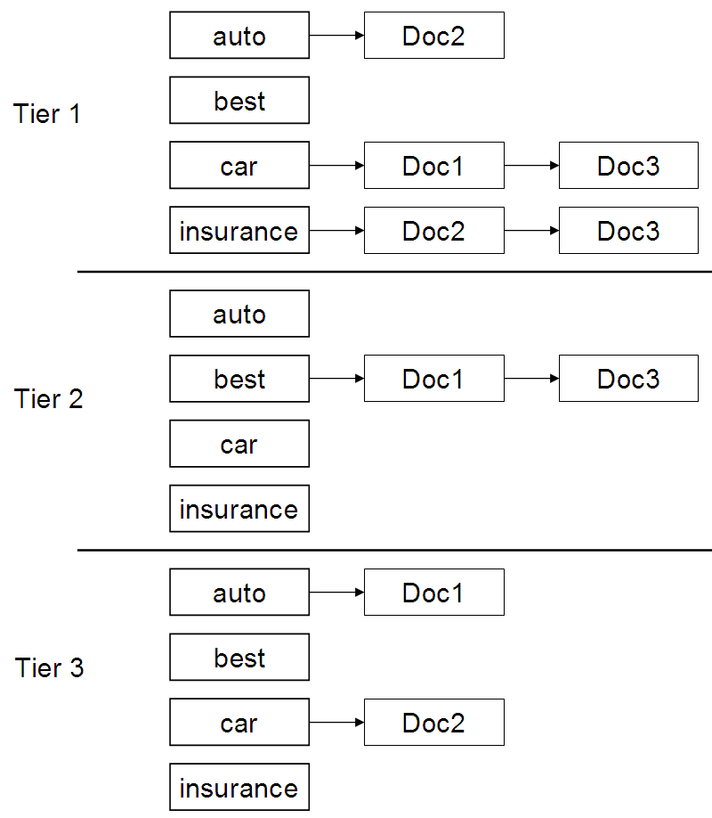
Example tiered index

Slide 48
Query term proximity
Free text queries: just a set of terms typed into the query box – common on the web
Users prefer docs in which query terms occur within close proximity of each other
Let w be the smallest window in a doc containing all query terms, e.g.,
For the query strained mercy the smallest window in the doc The quality of mercy is not strained is 4 (words)
Would like scoring function to take this into account – how?

Slide 49
Query parsers
Free text query from user may in fact spawn one or more queries to the indexes, e.g., query rising interest rates
  Run the query as a phrase query
  If <K docs contain the phrase rising interest rates, run the two phrase queries rising interest and interest rates
  If we still have <K docs, run the vector space query rising interest rates
  Rank matching docs by vector space scoring
This sequence is issued by a query parser

Slide 50
Aggregate scores
We’ve seen that score functions can combine cosine, static quality, proximity, etc.
How do we know the best combination?
Some applications – expert-tuned
Increasingly common: machine-learned

Slide 51
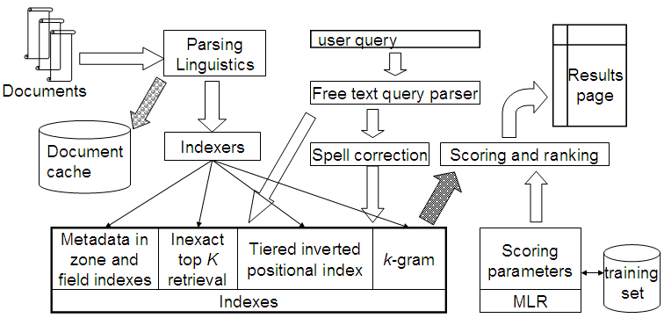
Putting it all together

